Slide 1
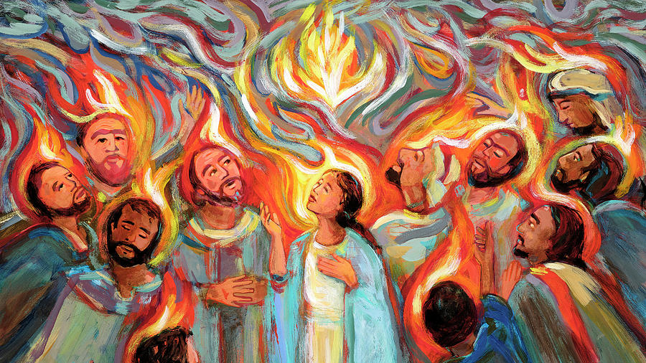
PENTECOST

Slide 3
Alleluia. Christ is Risen.
He is risen indeed. Alleluia!
The fire of God is coming! Sing praises
Sing praises to God.
The wind of God is blowing!
Sing praises.
Sing praises to God.

Slide 4
The joy of the Spirit is here!
Sing praises.
Sing Praises to God
Sing praises to God all the earth!
Sing praises.
Sing praises! Sing praises! Sing praises!

Slide 6
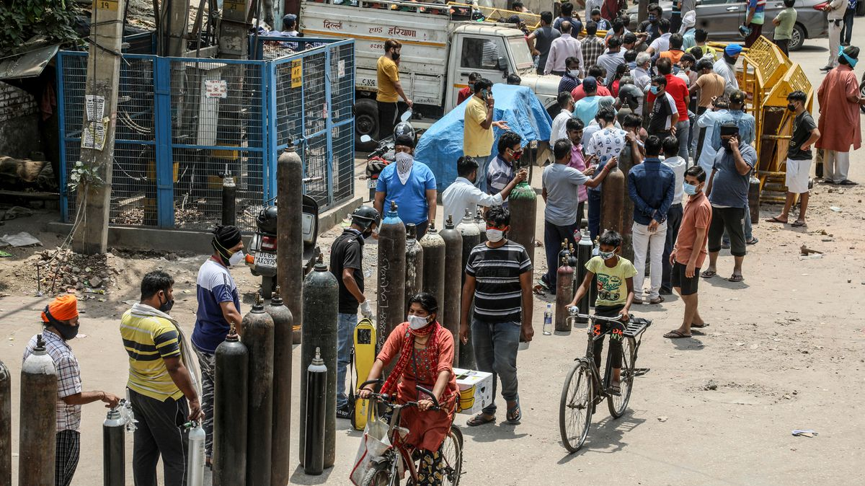

Slide 8
When we ignore you and go our own way,
Lord, have mercy.
Lord, have mercy.
When we forget your presence with us,
And become like dry bones,
Christ, have mercy.
Christ, have mercy.

Slide 9
When we do things in our own strength and not yours, Lord, have mercy.
Lord, have mercy.
Father forgive us through the death of Jesus, your Son, and strengthen us to live in the power of your Holy Spirit today and every day.

Slide 10
God says, ‘I will pour out my Spirit on everyone.’
Come, Holy Spirit and pour out your power on us and bring us life.

Slide 12
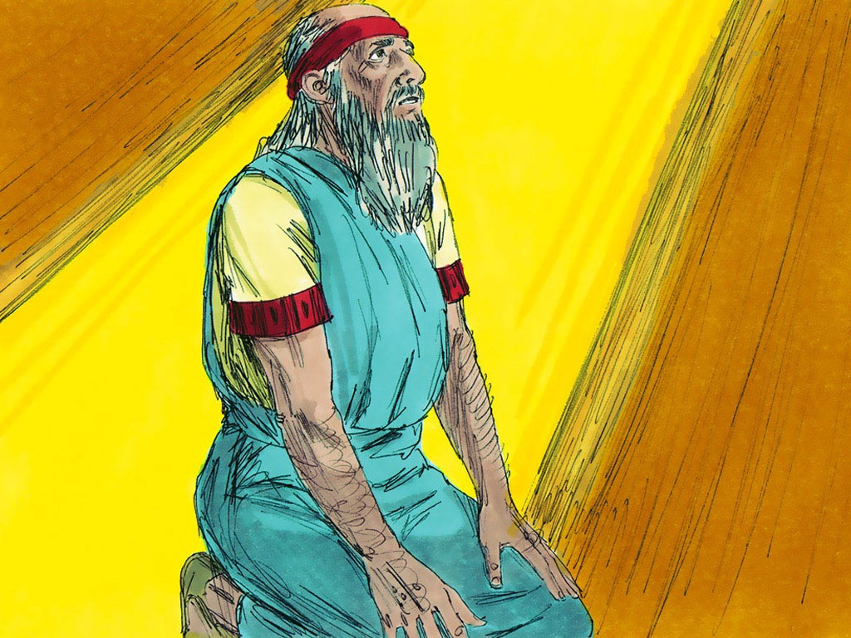

Slide 13
37 Some time later, I felt the Lord’s
power take control of me, and his
Spirit carried me to a valley full of
BONES. ² The Lord showed me all
around, and everywhere I looked I
saw BONES that were dried out.

Slide 14
He said, “Ezekiel, son of man, can
these BONES come back to life?”
I replied, “Lord God, only you can
answer that.”
⁴ He then told me to say:

Slide 15
Dry BONES, listen to what the Lord is
saying to you, ⁵ “I, the Lord God, will
put breath in you, and once again you
will live. ⁶ I will wrap you with muscles
and skin and breathe life into you.
Then you will know that I am
the Lord.”

Slide 16
⁷ I did what the Lord said, but before I
finished speaking, I heard a rattling
noise. The BONES were coming
together! ⁸ I saw muscles and skin
cover the BONES, but they had no life
in them.

Slide 17
⁹ The Lord said:
Ezekiel, now say to the
wind, “The Lord God commands you
to blow from every direction and to
breathe life into these dead bodies,
so they can live again.”

Slide 18
¹⁰ As soon as I said this, the wind
blew among the bodies, and they
came back to life! They all stood up,
and there were enough to make a
large army.
¹¹ The Lord said:

Slide 19
Ezekiel, the people of Israel are like
dead BONES. They complain that
they are dried up and that they have
no hope for the future. ¹² So tell
them, “I, the Lord God, promise to
open your graves and set you free. I
will bring you back to Israel,

Slide 20
¹³ and when that happens, you will
realize that I am the Lord. ¹⁴ My
Spirit will give you breath, and you
will live again. I will bring you
home, and you will know that I have
kept my promise. I, the Lord, have
spoken.”

Slide 21
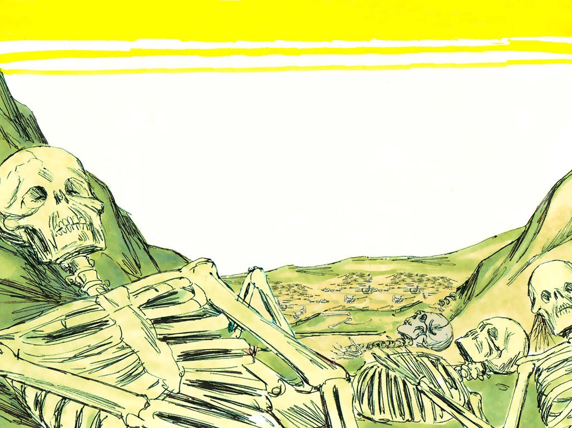

Slide 22
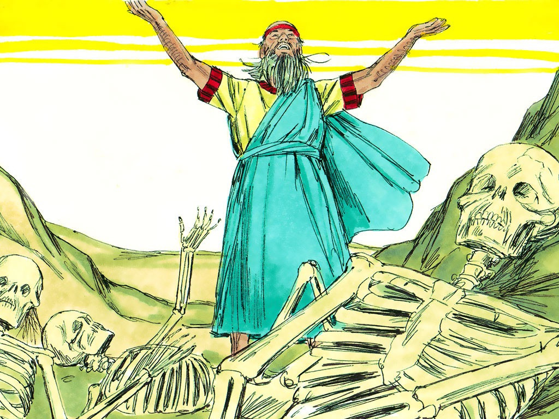

Slide 23
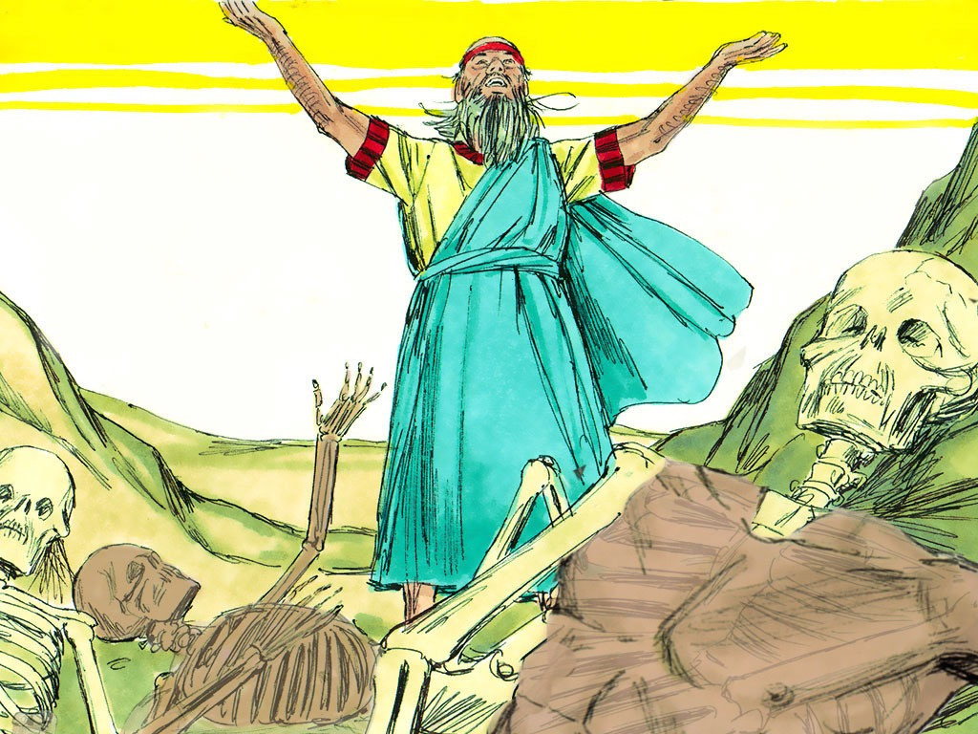

Slide 24
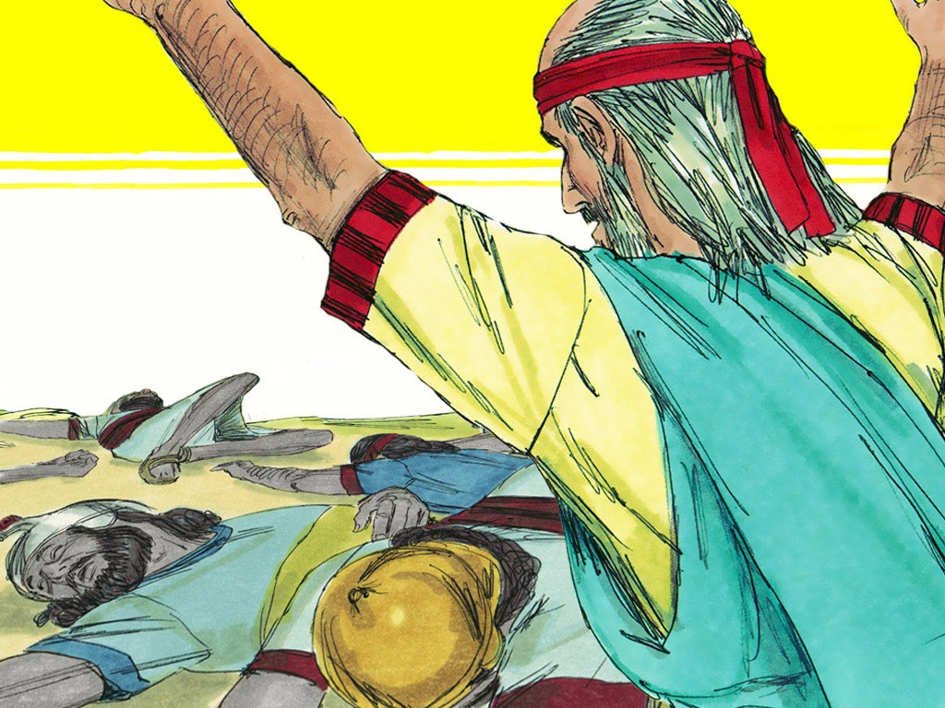

Slide 25
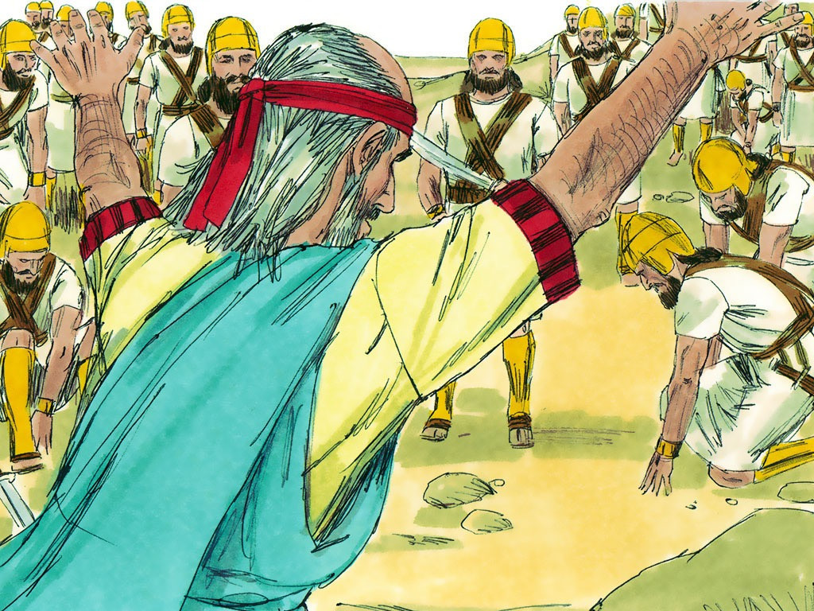

Slide 27
Listen, listen, listen
It was the day of Pentecost
And all the followers of Jesus were in one place
Suddenly…..
Suddenly….. there was the sound of a rushing wind
Woosh, woosh, woosh

Slide 28
A violent rushing wind from heaven
Woosh, woosh, woosh
And flames of fire appeared on everyone’s head
Crackle, crackle, crackle

Slide 29
And everyone began to talk in other languages
Mutter, mutter, mutter
And everyone
Could understand each other
Bonjour!

Slide 30
There were lots of visitors in Jerusalem from all over the known world
They were amazed at what was happening
And rushed up to find out more

Slide 31
There were Parthians, Medeans, Mesopotamians, Judeans, Cappadocians,
Pontians, Asians, Phrygians, Pamphylians, Egyptians, Libyans, Romans, Cretans, Arabians and Elamites.

Slide 32
But none from New Zealand!
And everyone could hear their own language being spoken
It was very confusing
So some said they must be drunk
So Peter stepped forward to speak to the crowd

Slide 33
It’s only 9 in the morning, he said,
We’re not drunk
No – all this is happening just as the prophet Joel said
He said there will come a day when there will be
Visions and prophecy

Slide 34
Not just for a few
But for men and women, sons and daughters, boys and girls
Even on slaves
Even on slaves!

Slide 35
And there will be signs of fire and mist and darkness and noise
For it is the great and glorious day of the Lord
And everyone who calls on the name of the Lord shall be saved!

Slide 37
Write any questions you have about the Holy Spirit

Slide 38
WORDS PICTURE VERSE SONG PRAYER

Slide 39
Be still, for the presence of the Lord,
the Holy One is here;
Come bow before him now
with reverence and fear.
In him no sin is found,
we stand on holy ground;
Be still for the presence of the Lord,
the Holy One is here.

Slide 40
Be still, for the glory of the Lord,
is shining all around;
He burns with holy fire,
with splendour He is crowned.
How awesome is the sight,
our radiant King of light;
Be still, for the glory of the Lord
is shining all around

Slide 41
Be still, for the power of the Lord,
is moving in this place;
He comes to cleanse and heal,
to minister His grace.
No work too hard for Him;
In faith receive from Him;
Be still, for the power of the Lord
is moving in this place

Slide 42
WORDS PICTURE VERSE SONG PRAYER

Slide 44
From the ends of the earth
We will sing; God is here,
the kingdom is near
In the Land of the Long White Cloud
Christ to dwell, Immanuel

Slide 45
From north and south,
from east and west
Beneath the Southern Cross we rest
Found by One who came for all
In this tale of spacious love
we're born

Slide 46
This whenua on which we stand
This holy ground
made by God's hand
Marred and scarred
yet marked by grace
Held and healed in Christ
we find our place

Slide 47
From the ends of the earth
We will sing; God is here,
the kingdom is near
In the Land of the Long White Cloud
Christ to dwell, Immanuel

Slide 48
God of nations, at thy feet
In the bonds of love we meet
Strangers once, now called as one
Aotearoa, wake to greet this love

Slide 49
From the ends of the earth
We will sing; God is here,
the kingdom is near
In the Land of the Long White Cloud
Christ to dwell, Immanuel

