Slide 1
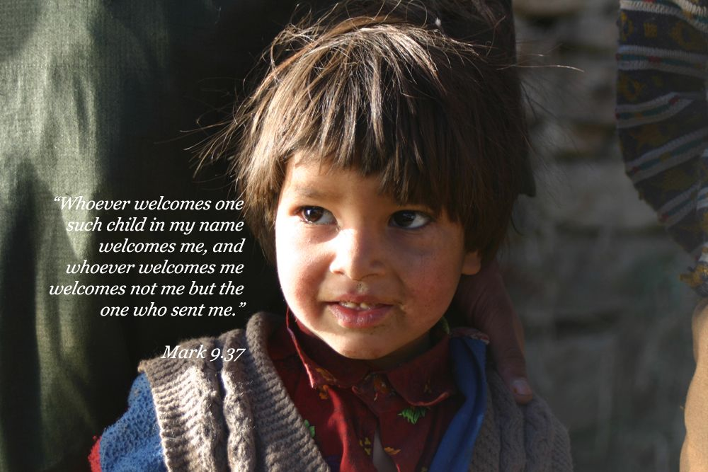
Praying for children Karakia Mo Ngā Tamariki
2-8 August 2020
Notes:
The 7 daily phrases are highlighted in the PPT with a story to go with each. Depending on your time and context, choose some of the stories below when sharing the PPT on Sunday 2 August, to introduce the week’s prayer focus.
Make the bookmarks available before or after the power point.

Slide 2
Make Space
Notes:
MAKE SPACE
Many churches have already thought carefully about a physical space for children in the Sunday worship. The Children & Families team recommend a suitable space at or near the front where children can see, hear and participate more easily. One church who did this recently noticed a boy who usually sat with Grandma near the back joining in for the first time. Two other children had physical difficulties. When the children were asked what they liked, they said they ‘felt safe.’
Often a kids’ area in a back corner of the church can give the unspoken message that ‘worship isn’t for children, just keep them quiet and entertained until they go out’, but Jesus said: ‘Let the children come to me and do not hinder them.’ What SPACE (physical and invitational) is being made in your church for children to participate?

Slide 3
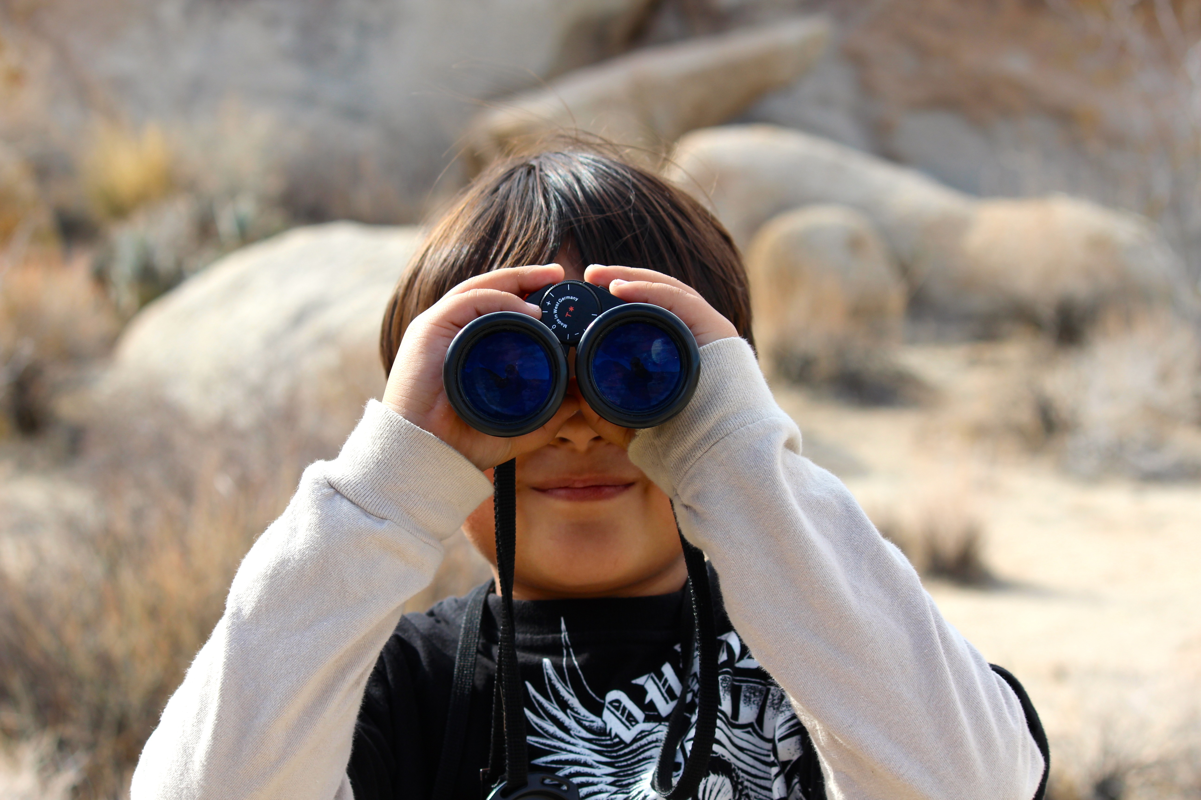
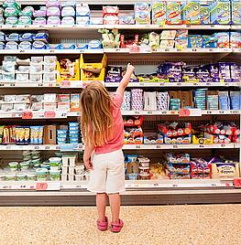
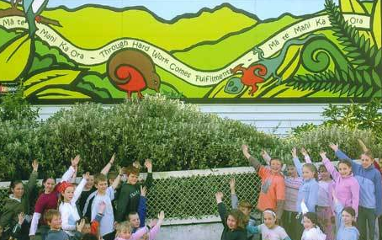
Look Around
Notes:
Take a walk this week around your neighbourhood and notice:
How many children live in your street? What are families up to? Where is your nearest primary school or early childhood centre? Where else do you notice children e.g. at parks, playgrounds, the supermarket and shopping areas?
How well are children with physical difficulties catered for e.g signs and access?
As you walk, pray for the children and the families you see, plus those you don’t see but you know that they are there.
What might God want you to notice?

Slide 4
What would it take?
Notes:
Family Works Otago run a Growing Taller programme for children, many of whom have difficulty managing their emotions. Our facilitators talk about the importance of adults taking the time to talk positively with and about children.
A child said “When I got in the car and you (the parent) said I’m really pleased to see you, I just about jumped out of my car seat.”
When asked “What would you like people to say about you?”, the children responded that they would like to hear that they are kind, caring and they have good ideas.
What would it take? Examples of kind words…. I think about you when we’re apart, my world is better with you in it, you make me smile.

Slide 5
How does it feel?
Notes:
HOW DOES IT FEEL?
A girl with Down Syndrome invited 15 people to her birthday party. Sadly, she never received any invitations to their parties. It is so important to be included. Yes, it is hard work sometimes - there might be behavioural issues/difficulties.
Ask the parents of the child how to navigate these difficulties. The parents might need to be there for a while to ensure that their child is ok. Parents get hurt as much as the children do. They want to make sure their child is ok and not left at the back of the hall by themselves. They have to know that they can ‘trust’.
Think about what it is like for someone with a learning disability. Make sure at church or at a party or in a playground there are signs that are easy to read, good pictorials, and think about what it is like for someone living with a learning disability.
It’s not easy ………………. But…

Slide 6
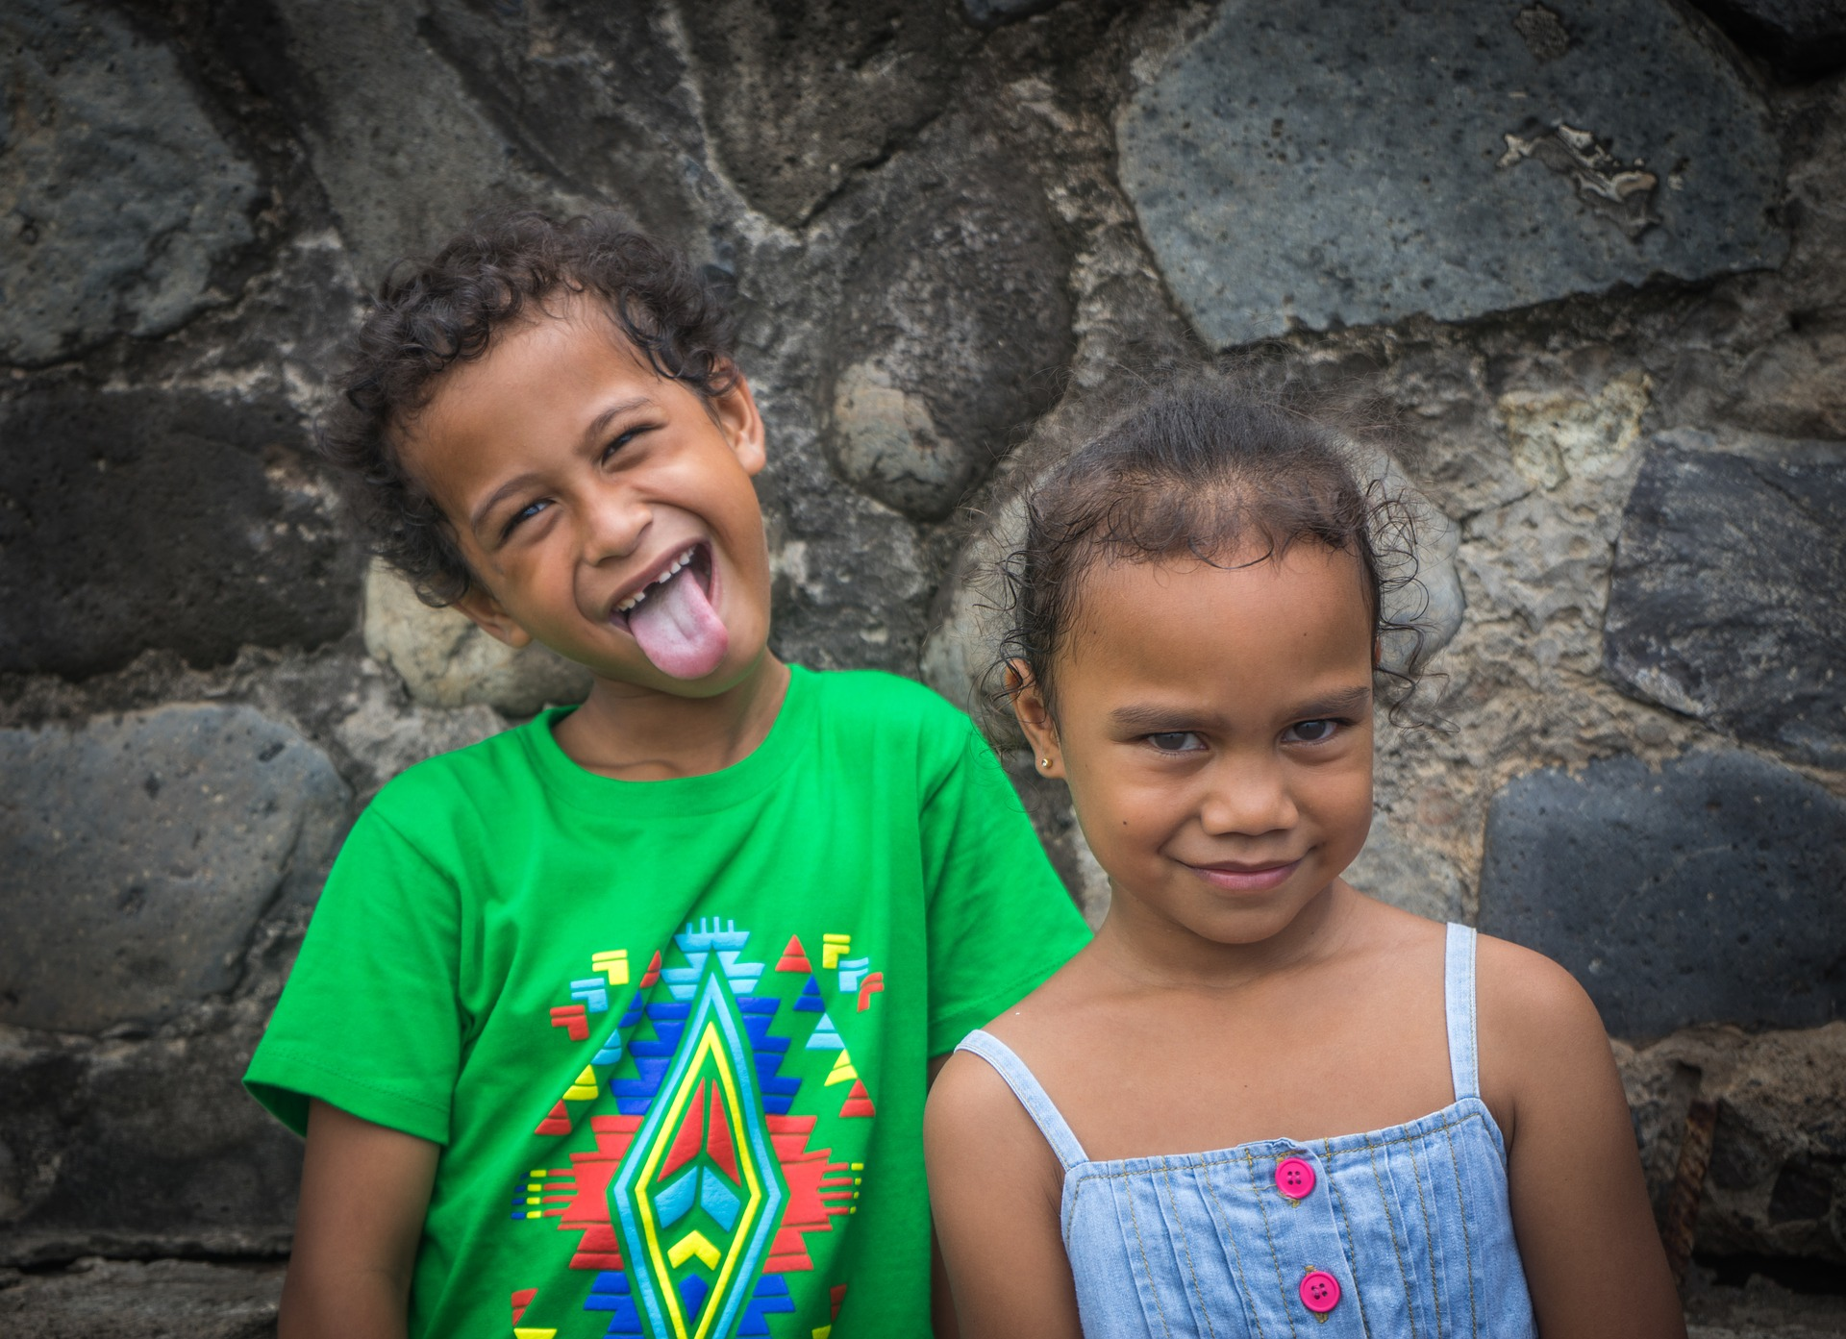
Celebrate!
Celebrate!
Notes:
CELEBRATE!
Many churches include celebrations or ‘God moments’ in a sharing time in church – often with a lolly or a chocolate jar! In one large church, people of all ages come to the front to share into the microphone before a group prayer or blessing. This could take quite a while some weeks, and a question came up at one staff meeting: ‘Was there some way to filter out the less important celebrations like a win at soccer or losing a tooth because those children are probably just coming up to get a chocolate anyway! A robust discussion followed!
It was a good time to review the practical details of that slot in the service but the church leaders were able to affirm again the importance of this all-age celebration time. As someone said, ‘In the eyes of the 5 year old, their lost tooth WAS as important as the 90 year old birthday.’
How do we include children in our faith community celebrations?
Can children show us something more about celebrating the simple joys of life?

Slide 7
Let’s bother to…
Notes:
LET’S BOTHER TO ….
By taking the time to learn to care, the gifts of engagement are often far greater than any difficulties.
At the beginning of the Level 4 lockdown, a single mother needed to go to the supermarket and there was no one to look after her special needs daughter, so she had to take her along. It was during the days of only one person being allowed into the supermarket at a time. The supermarket wouldn’t let the mother take her child in with her.
Another woman in the queue offered to sit with the child in the car so that the mother could do the shopping. This woman willingly gave up her place in the queue to help someone else: there was generosity of recognising there was a need. The mother was willing to trust this stranger with her daughter. The mother knew her child was safe and that she was able to buy food for them.

Slide 8
Let’s be better
‘Anyone who welcomes one of these little children in my name welcomes me.’
Mark 9:37
Notes:
LET’S BE BETTER
As Christians, God calls us to ‘be better’. Jesus certainly had plenty to say about the way people behaved towards one another and challenged people to ‘do better’. On more than one occasion, he used a child to help illustrate his point. Do you remember this story, which has been recorded 3 times in the gospels of Matthew, Mark and Luke? Let’s listen again…
One day, the disciples were arguing with each other about who was the best. Who could run the fastest? Who did Jesus like most? Who got the most important jobs? Who was the smartest? We don't know for sure what they were arguing about - we can only guess.
Then Jesus called them over to him and asked what they had been talking about....they looked at the floor and said nothing. So Jesus decided it was time for a lesson. He told them that if they really wanted to be the greatest, they had to learn how to be gentle, humble and kind. They had to remember how to be open, curious and keen to learn. They had to unlearn judging others by the way they look and instead learn to embrace those who are often overlooked. And to show them what he meant, he called a child over and wrapped his arms around the little one and said "Whoever welcomes one such child in my name welcomes me..."

Slide 9
Praying for children
Take a bookmark.
Commit to reading the printed prayer and different phrase each day
to guide your prayer and action.
For a daily story and more ideas
go to www.pcfm.org.nz
And a daily blog https://prayingforchildren2020.wordpress.com/blog-2/

